Slide 1
LSTM Application for US and Cryptocurrencies
FIN 4093
May 6th 2025
Prof. Sandeep
Arda Dinc

Slide 2
AGENDA
01
What is an LSTM?
04
Results & Takeaways
02
Key Research Study
05
CLOSING
03
My LSTM Project

Slide 3
01
Background

Slide 4
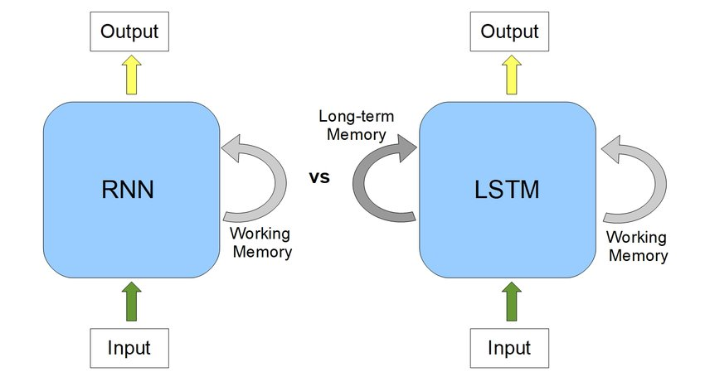
What is LSTM
- Traditional models don’t remember past inputs — but time-series, language, and speech depend on order
- Sequence models like RNNs are designed to handle data that evolves over time
- Vanilla RNNs often suffer from the vanishing gradient problem: they forget long-term information

Slide 5
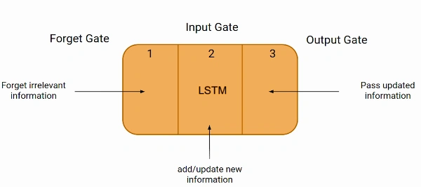
What is LSTM
LSTMs solve the forgetting issue by using a "cell state" that carries long-term memory
They also use a hidden state that captures short-term dynamics
Three gates control memory:
Input gate: What new info to write
Forget gate: What old info to erase
Output gate: What to send to the next step

Slide 6
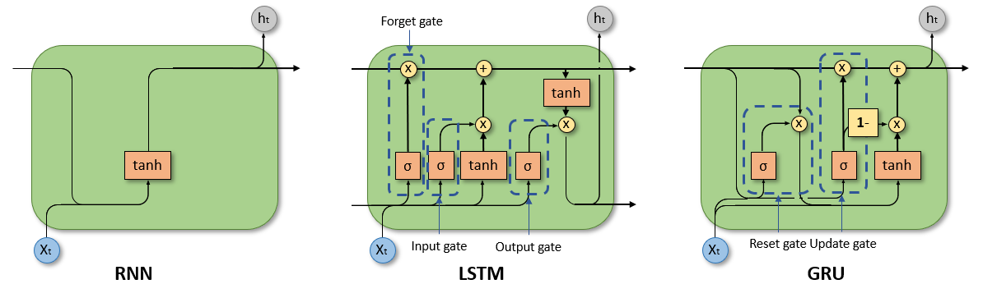
What is LSTM

Slide 7
02
Key Research Study

Slide 8
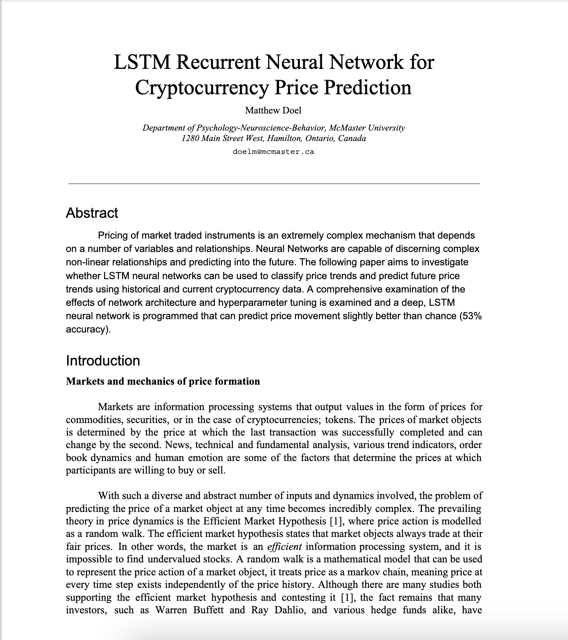
Key Research Study
Title: LSTM Recurrent Neural Network for Cryptocurrency Price Prediction Authors: Matthew Doel Published: April 2019 Goal:
Investigate whether LSTM neural networks can classify and predict cryptocurrency price trends using historical data.
Analyze how network architecture and hyperparameter tuning affect prediction accuracy in time series forecasting.

Slide 9
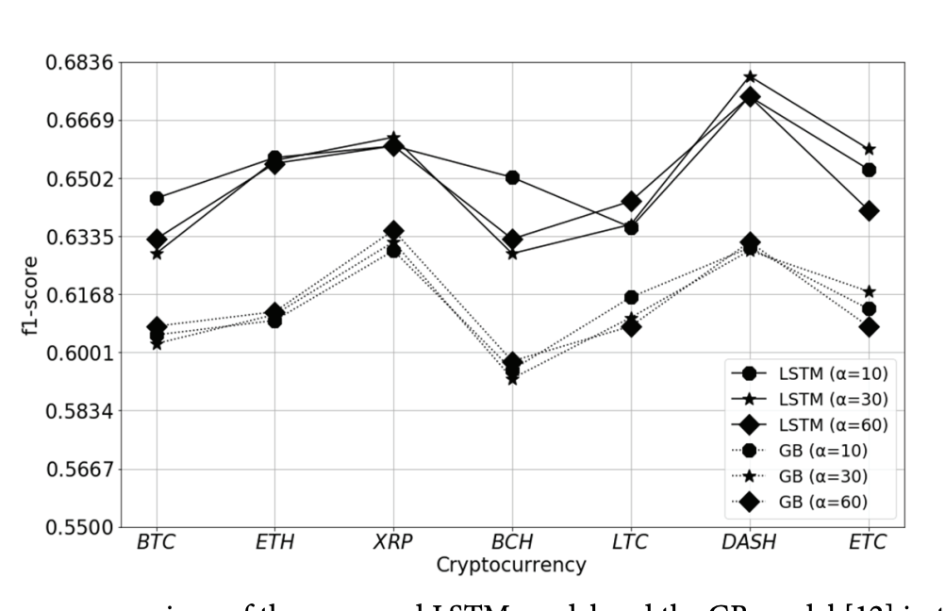
Key Research Study
Data: Historical cryptocurrency trading data (BTC-USDT, ETH-USDT). Focused on predicting Buy/Sell movements
Input format: Time series formatted to exclude majority “hold” conditions, enhancing anomaly detection.
Model: LSTM-based neural network trained on BTC-USDT. Accuracy based on correct Buy/Sell predictions only ("true accuracy").
Comparison:
Highest accuracy on BTC-USDT (59.57%)
Similar performance on ETH-USDT (53.38%) due to similar price dynamics
Lower accuracy on unrelated pairs like ETH-BTC (49.13%)

Slide 10
03
My LSTM Project

Slide 11
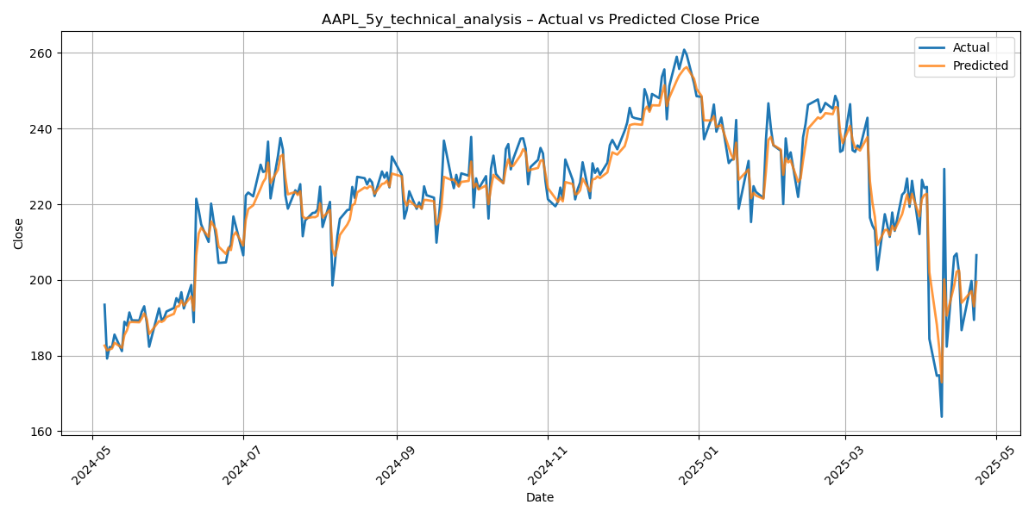
My LSTM Project
Predict short-term price returns for stocks and cryptocurrencies
Compare performance across asset types using directional accuracy and error metrics
Create a composite score to rank assets by LSTM prediction quality

Slide 12
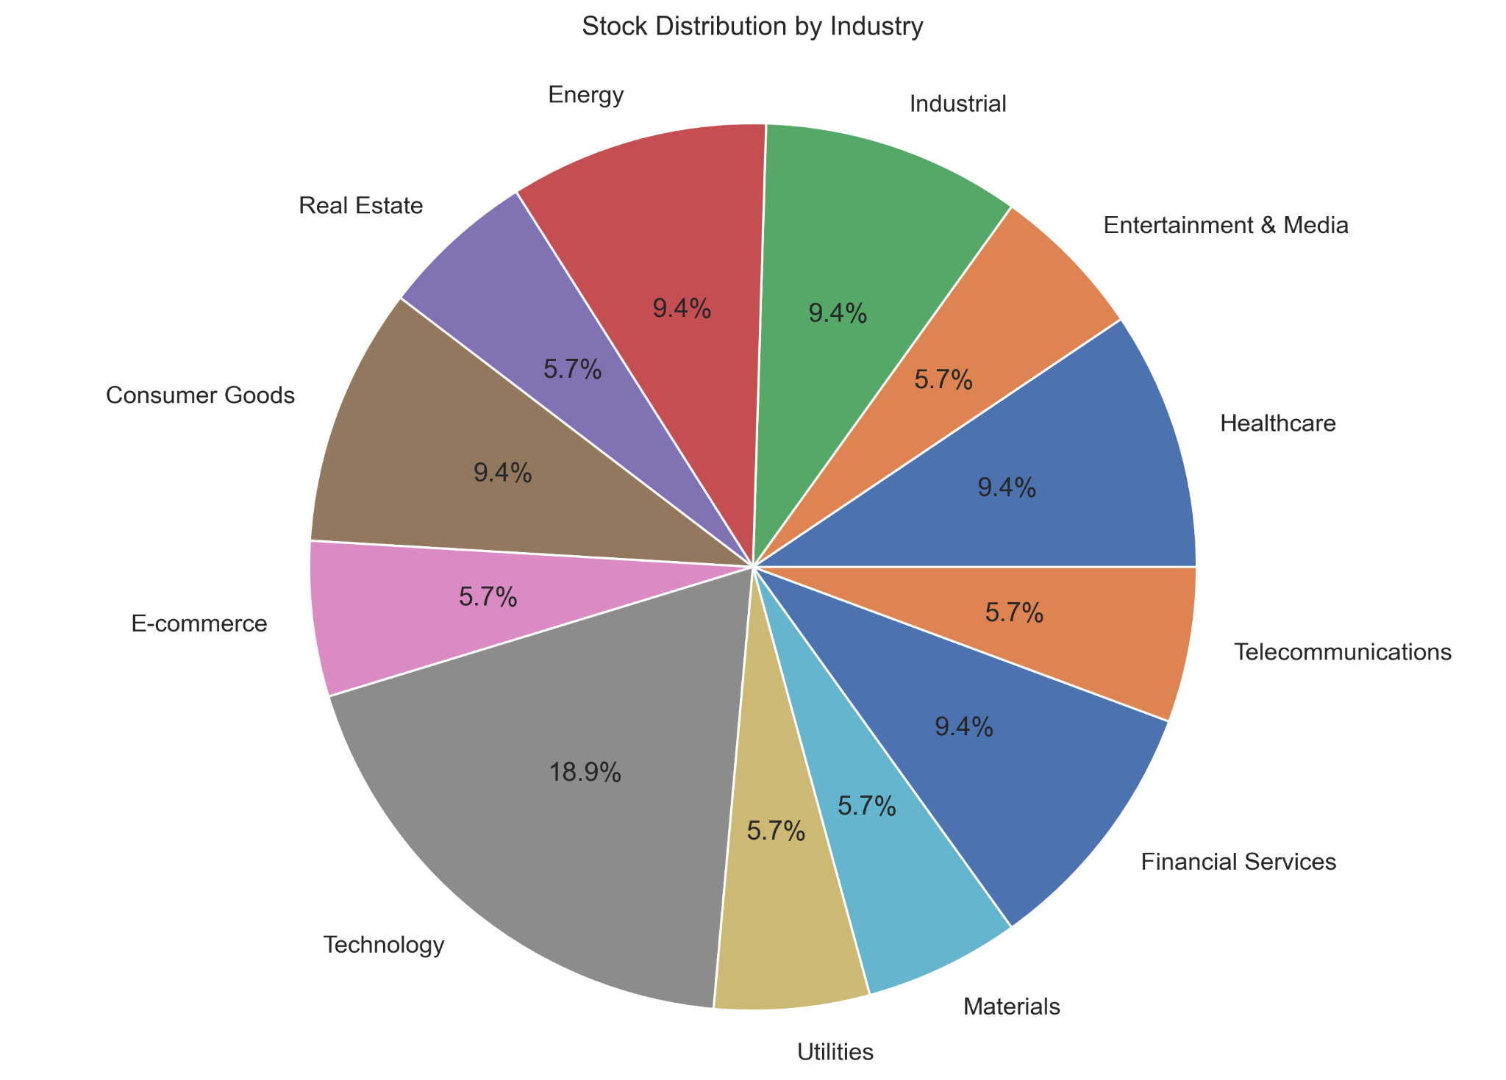
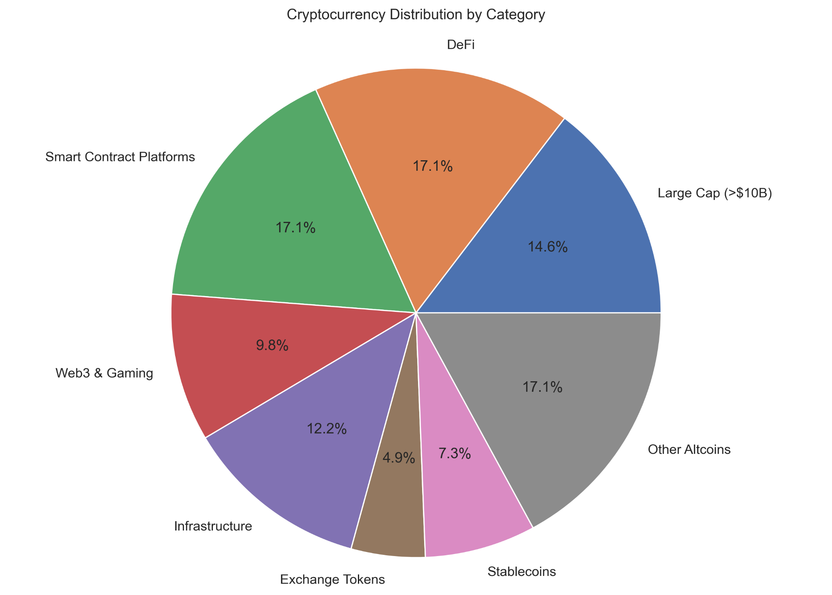
My LSTM Project

Slide 13
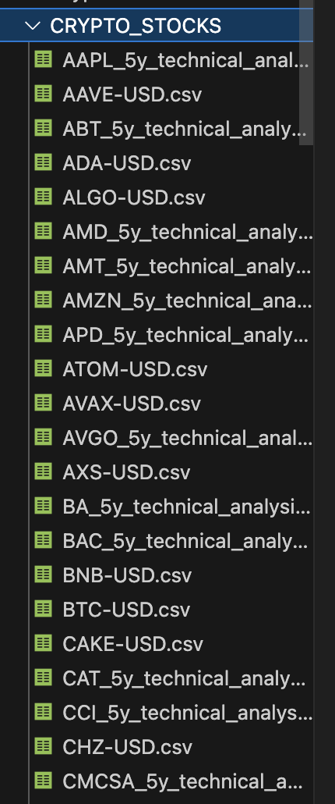
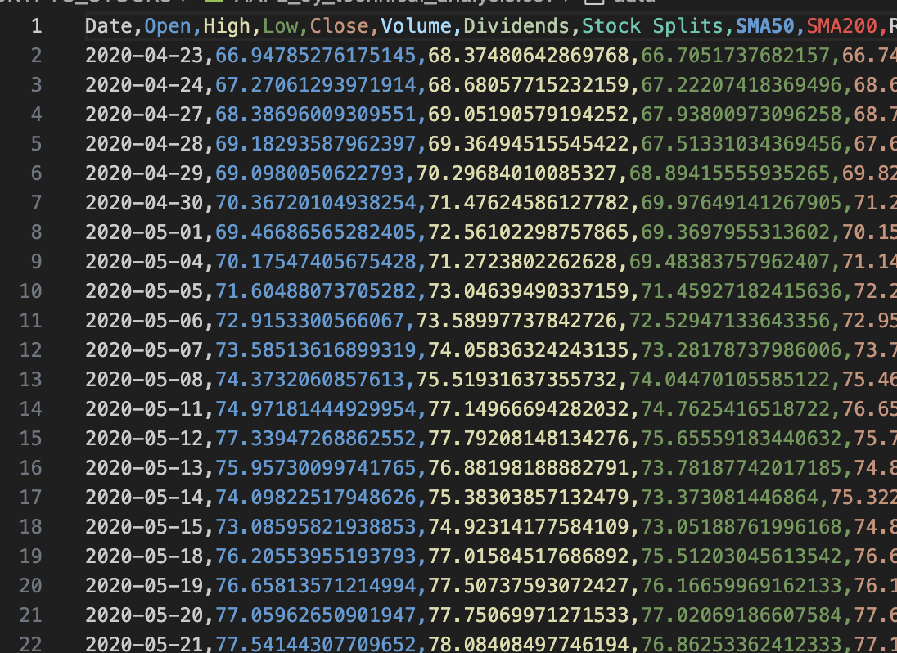
My LSTM Project
Loads & cleans data from crypto/stock CSVs from yahoo finance
Scales features (Open, High, Low, Close, Volume) with RobustScaler
Creates sequences (past 50 days → predict next-day return)
Trains 3 LSTM models ensemble with different dropout rates (0.15, 0.20, 0.25)
Uses Huber loss + early stopping for stable training (stops after 10 epochs)
Averages predictions from all 3 models

Slide 14
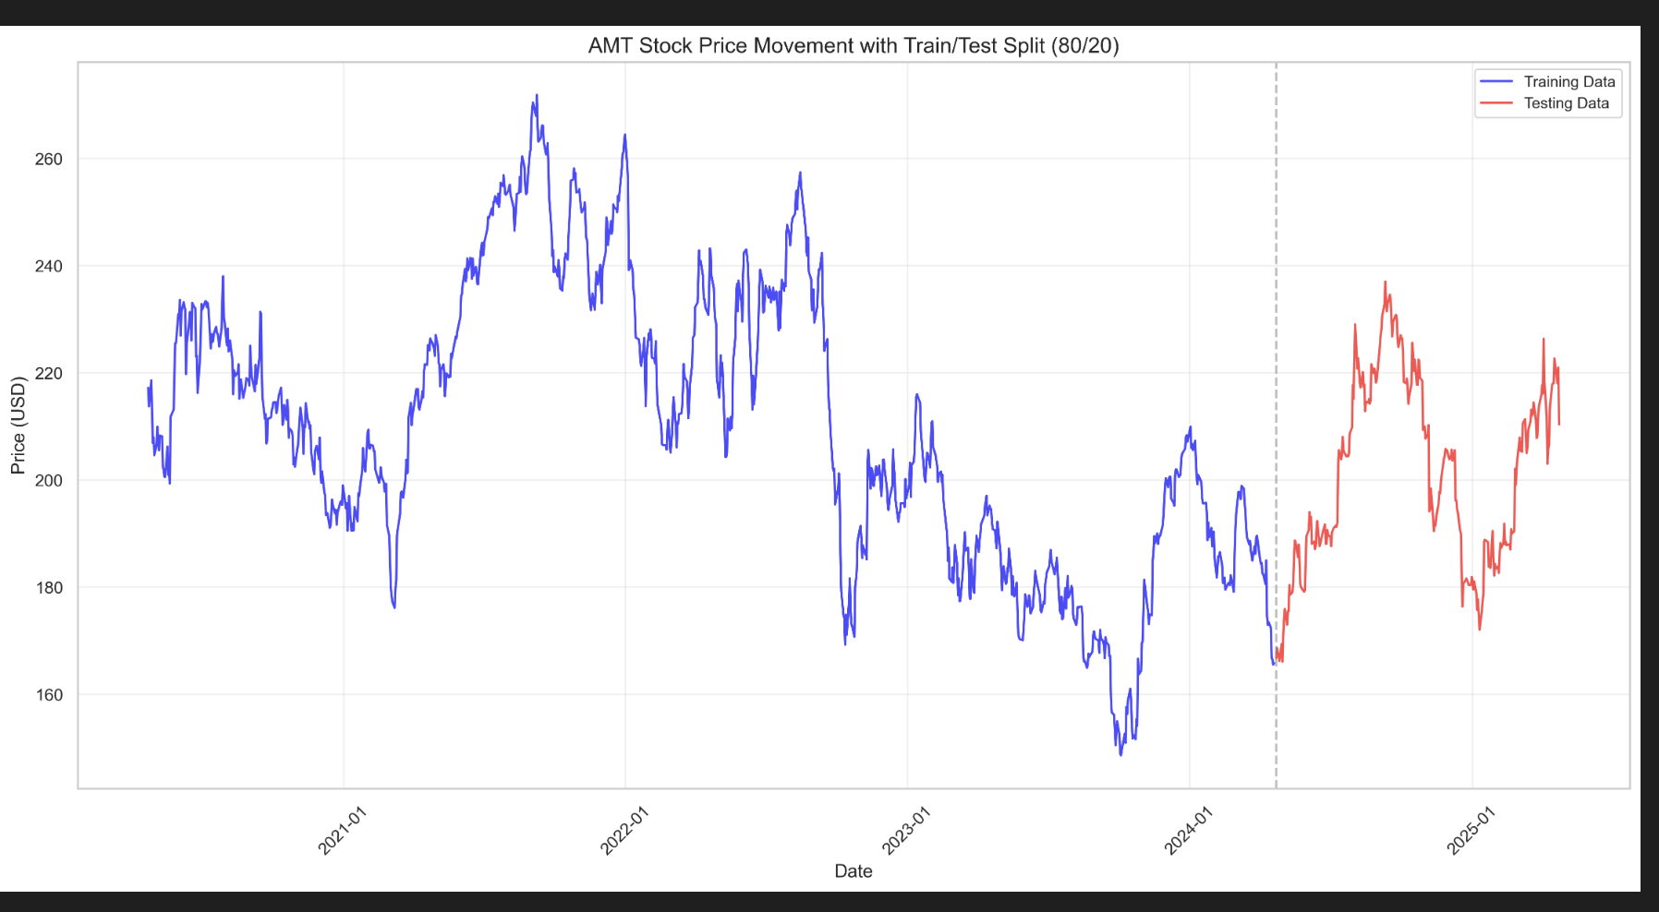
My LSTM Project
Train/test split: 80/20 per asset
Architecture:
2 stacked LSTM(50) layers
Final Dense(1) for return prediction
Validation strategy: 10% of training set
Learning Rate Scheduling:
ReduceLROnPlateau: halves LR if no improvement in 5 epochs
Minimum LR capped at 1e-6
Epochs: Max 80, but often ends earlier due to early stopping

Slide 15

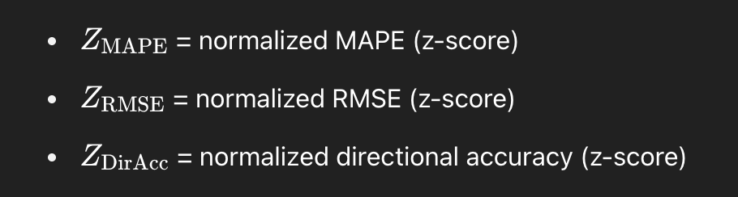
My LSTM Project
Directional Accuracy → % of times the model correctly predicted the price direction (up or down)
RMSE (Root Mean Squared Error) → Measures the average size of prediction errors → Larger errors are penalized more (sensitive to outliers)
MAPE (Mean Absolute Percentage Error) → Measures average % error between predicted and actual prices → Easier to interpret across different asset price scales

Slide 16
04
Results & Takeaways

Slide 17
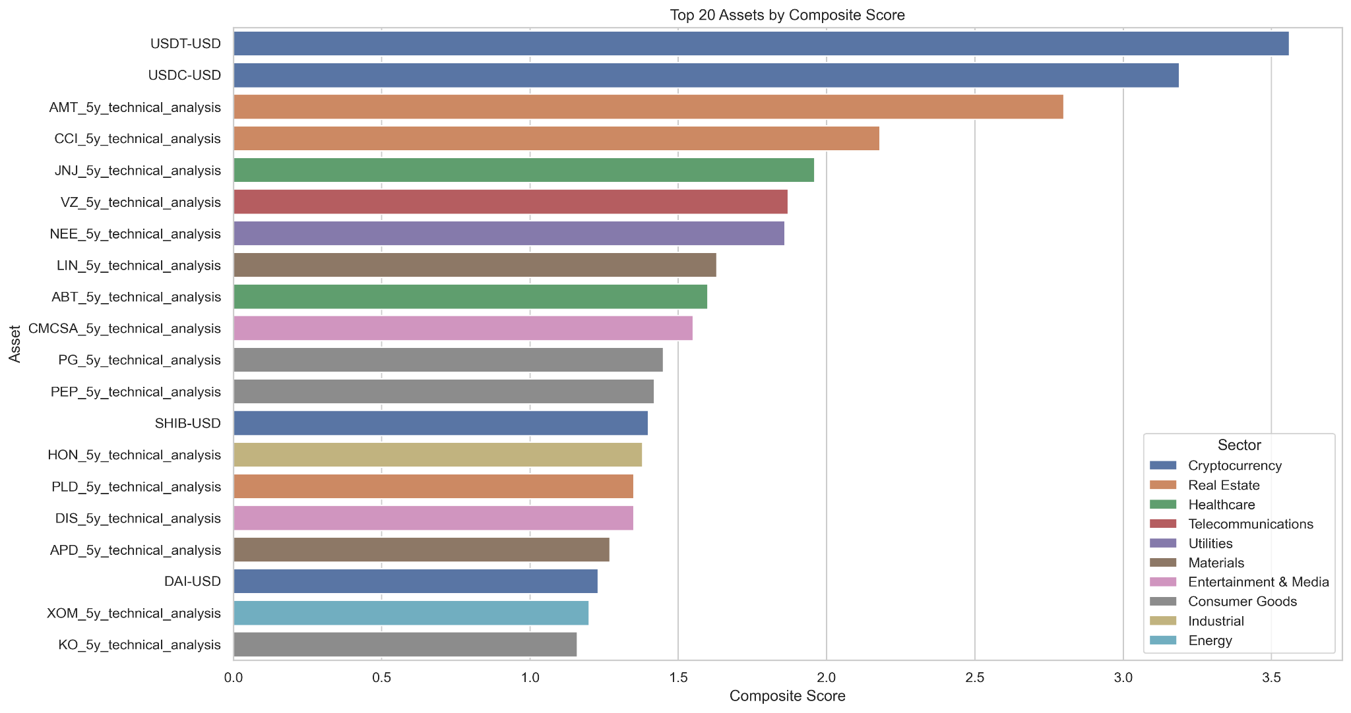
BAR CHART
Top-performing assets based on combined LSTM prediction metrics (accuracy, error, consistency)

Slide 18
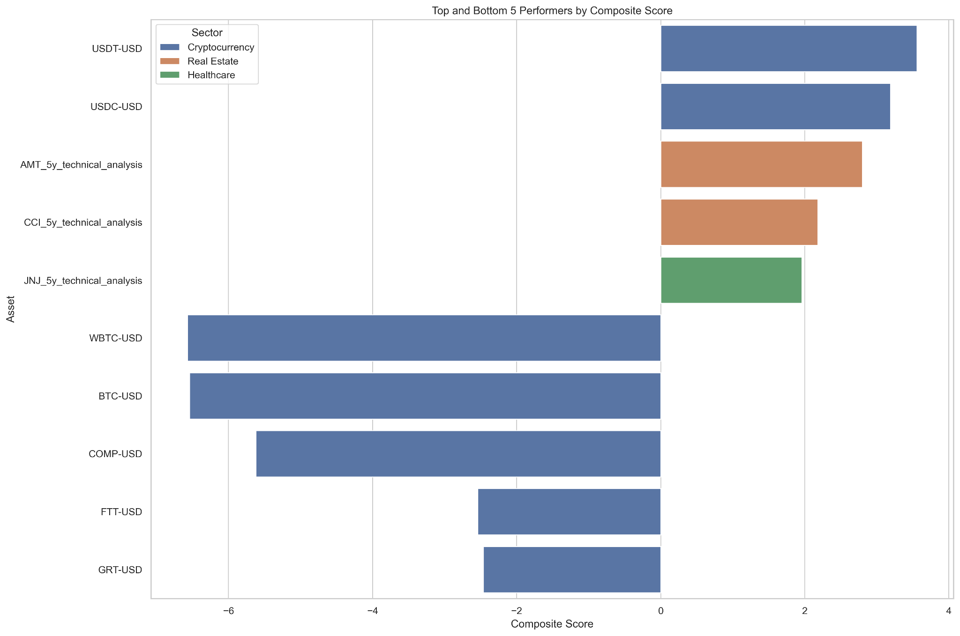
Top & Bottom Performers by Composite Score

Slide 19
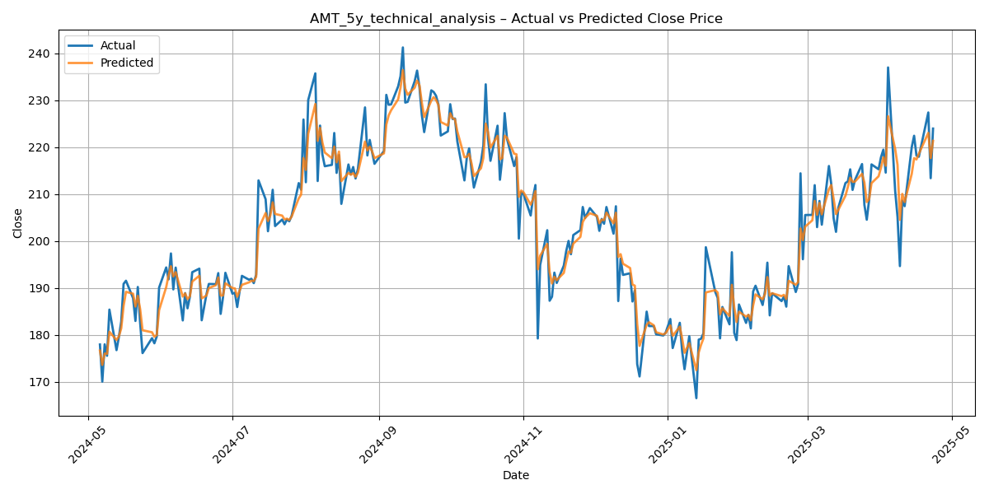
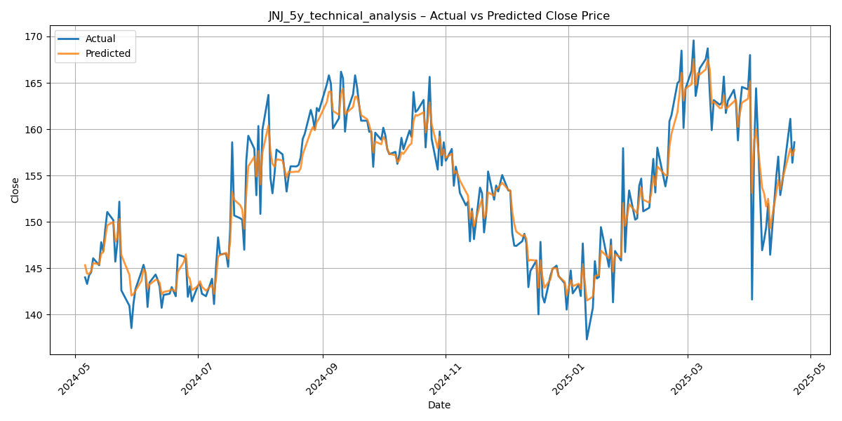
Prediction Accuracy: Stock Case Studies
Top Scoring

Slide 20
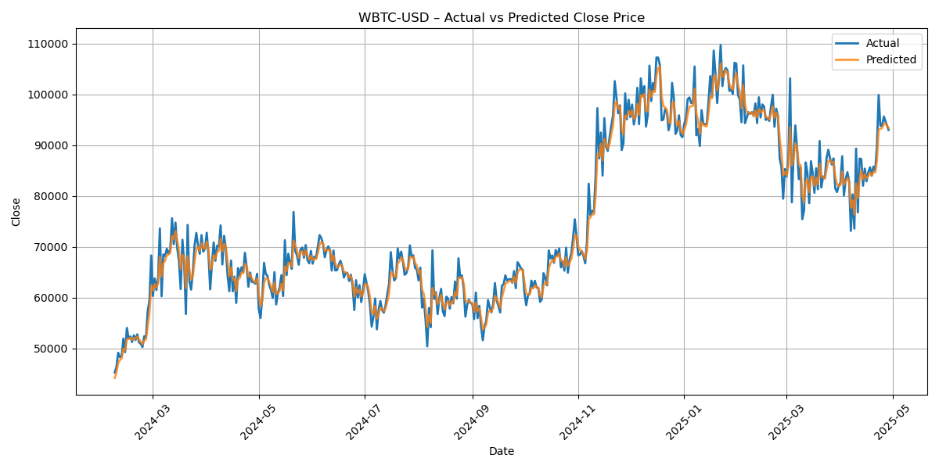
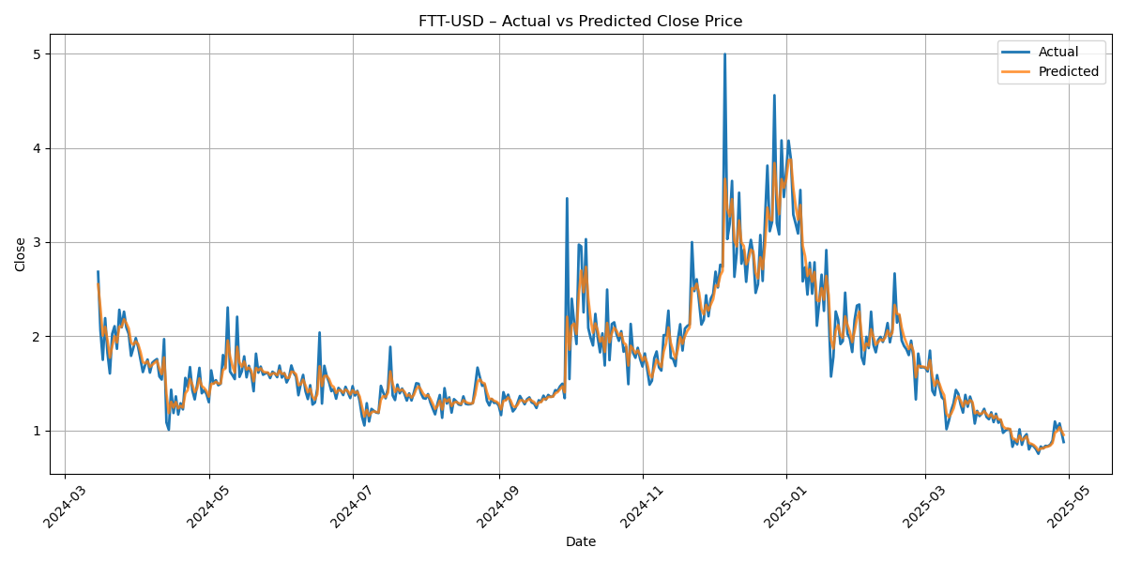
Prediction Accuracy: Stock Case Studies
Bottom Scoring

Slide 21
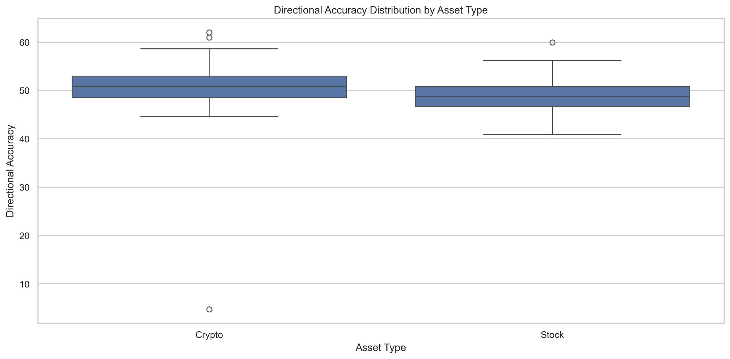
LSTM Directional Accuracy Across Asset Types
Cryptocurrencies slightly outperform stocks in predicting price direction

Slide 22
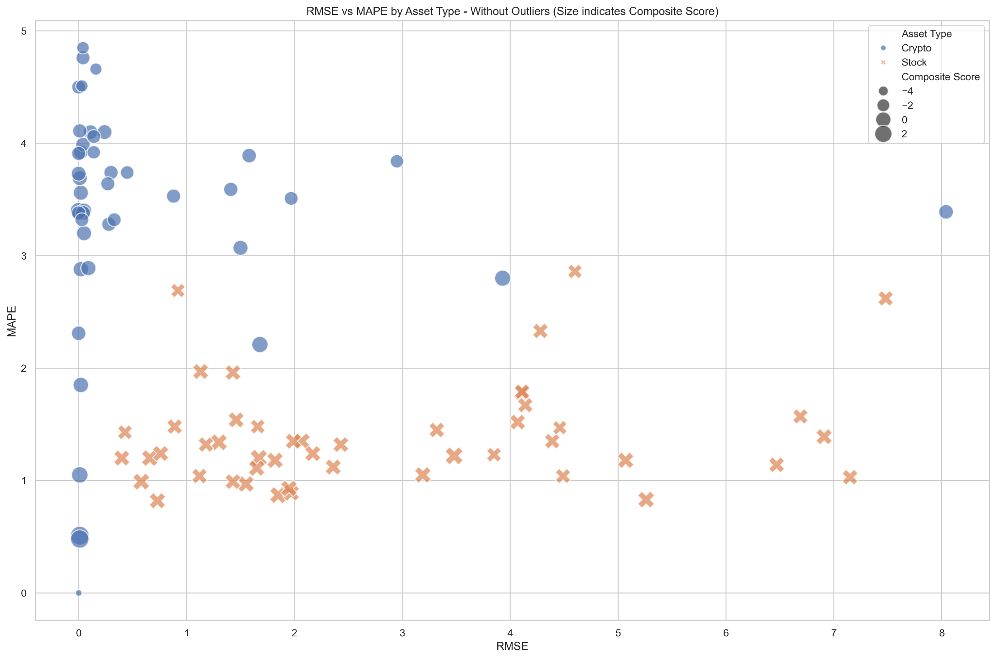
RMSE vs MAPE Scatter Plot by Asset Type

Slide 23
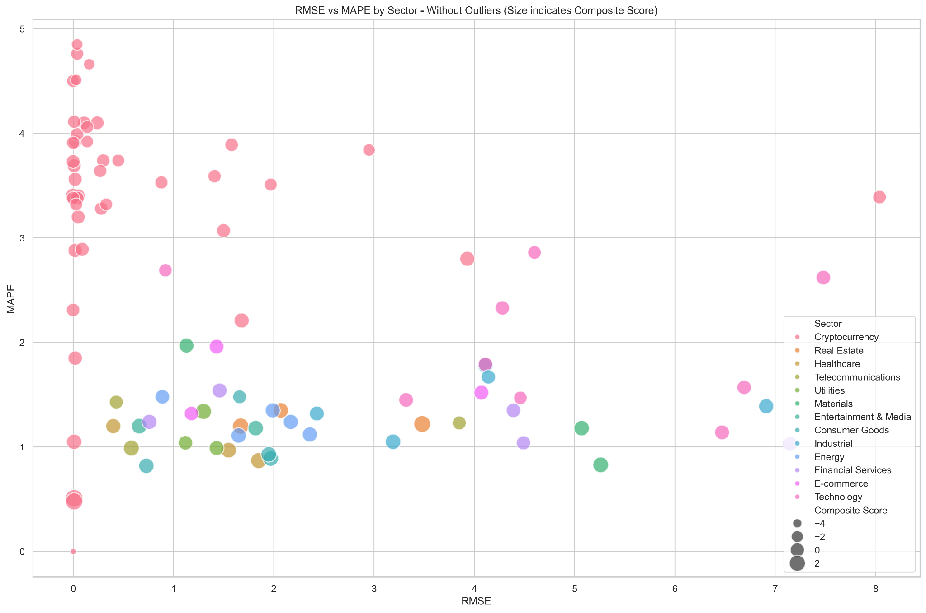
RMSE vs MAPE by Sector

Slide 24
Directional accuracy >50% across 45 assets (26 Stocks/19 Crypto)
Unified LSTM model handles both crypto and stocks
Composite scoring helps rank asset predictability meaningfully
Strengths
Integrate transformer layers for deeper sequence insights
Integrate TA indicators to enhance predictive accuracy across assets
Train separate models per sector for specialized learning
Opportunities
Crypto showed high volatility in error metrics (high MAPE)
Model performance plateaus beyond certain sequence lengths
Results can vary heavily by asset liquidity and volatility patterns
Weaknesses
Takeaways

Slide 25
GeeksforGeeks. Deep Learning | Introduction to Long Short-Term Memory (LSTM), 20 Sept. 2021, www.geeksforgeeks.org/deep-learning-introduction-to-long-short-term-memory/. Accessed 5 May 2025.
Analytics Vidhya. What Is LSTM? Introduction to Long Short-Term Memory, 10 Mar. 2021, www.analyticsvidhya.com/blog/2021/03/introduction-to-long-short-term-memory-lstm/. Accessed 5 May 2025.
IBM. Recurrent Neural Networks (RNNs), www.ibm.com/think/topics/recurrent-neural-networks. Accessed 5 May 2025.
References

Slide 26
05
THANK YOU
Questions?

